Slide 1
DW Concepts
By Rajesh Kumar V.S
Aroha Technologies
www.aroha.co.in
www.ilearnonline.co.in
rajesh@aroha.co.in
rajesh.k.shanmugam@gmail.com

Slide 2
Agenda – for the program
Introduction
Expectations
Introduction to DW
Definition of DW
End users for DW
Architecture of DW
Sub Systems of DW
Stages of DW
Data Modeling in DW
BI Layer
Questions

Slide 3
Before we begin…..
What is Data?
What is a Database?
What is an RDBMS?
Relation
What is a Data Model?
Why we follow Normalization while designing data model?
What is an OLTP system
What is an application layer and data layer?

Slide 4
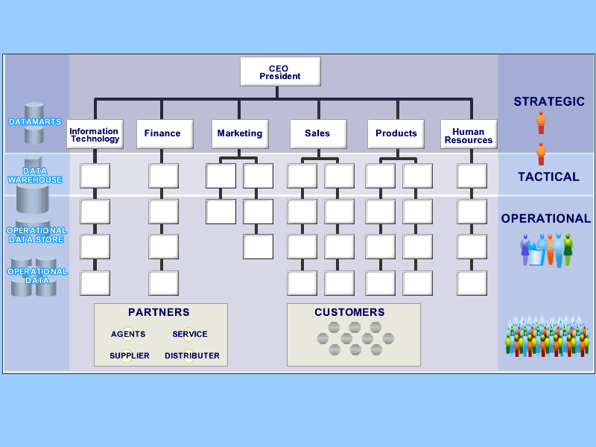
Organization…..

Slide 5
What is a Data Warehouse?
A single, complete and consistent store of data obtained from a variety of different sources made available to end users in what they can understand and use in a business context.
[Barry Devlin]

Slide 6
What is Data Warehousing?
A process of transforming data into information and making it available to users in a timely enough manner to make a difference
[Forrester Research, April 1996]
Information
Data

Slide 7
Typical Problem with out a DW
I can’t find the data I need
data is scattered over the network
many versions, subtle differences
I can’t get the data I need
need an expert to get the data
I can’t understand the data I found
available data poorly documented
I can’t use the data I found
results are unexpected
data needs to be transformed from one form to other

Slide 8
What top level business wants...
Data should be integrated across the enterprise
Summary data has a real value to the organization
Historical data holds the key to understanding data over time
What-if capabilities are required

Slide 9
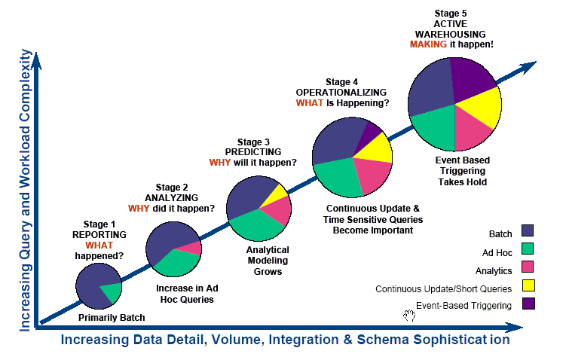
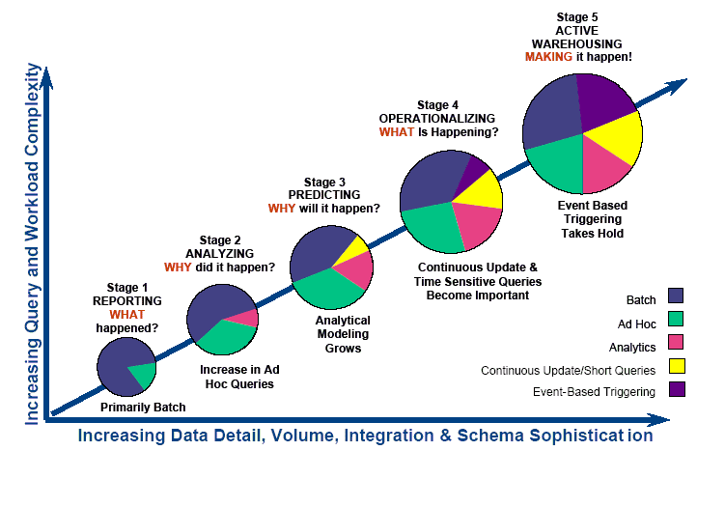
DSS Maturity Evolution – a journey
*Taken from “Assessing the Maturity of a Data Warehouse” - NCR
Increasing Integration/Sophistication and Strategic Value

Slide 10
General DSS Architecture
Source Data
Pre
Defined
Reports
Data
Warehouse
Database
ETL
(Tool or
TSQL)
OLTP 1
Ad hoc
Reporting
OLTP 2
ODS
Database
OLAP
Cubes
Market Place
Staging DB
Web clicks
Data Mining
Meta Data
Close the loop (write back to OLTP about the findings in DSS

Slide 11
One way of developing DW
Source Data
ET&L
Informatica /
Data Stage /
Ab Initio /
SSIS
&
Unix scripting
&
Database programming
………
Data
Warehouse
Database
Pre
Defined
Reports
HR Data
Finance
Ad hoc
Reporting
Web Log
EDW /
Data marts
OLAP
Cubes
Content
Market data
Data Mining

Slide 12
OLTP vs DSS
No change in the data (No updates and deletes)
Queries based on time period, set of products, set of customers etc
Maintains the history.
Used mainly for analytics (trend analysis, customer behavior etc)
More DML operations (Update, Delete, Inserts)
Point Queries
Very specific while issuing queries
Less history (approximately 6 months to 1 year)
Used for day today activities (must to run the business)
Follow the 3rd normal form data modeling to create the model.

Slide 13
Application-Orientation vs. Subject-Orientation
Application-Orientation
Subject-Orientation
Operational Database
Data
Warehouse
Credit
Card
Loans
Customer
Vendor
Product
Trust
Savings
Activity

Slide 14
Data Warehouses Vs Data Marts
Data Warehouse
Enterprise-wide
Industry follows E-R Model or Star schemas
Structure for corporate view of data
Data Mart
Departmental
Mostly Star Schema based (Facts and dimensions)
Quick turn around (up and running as there are less stakeholders)

Slide 15
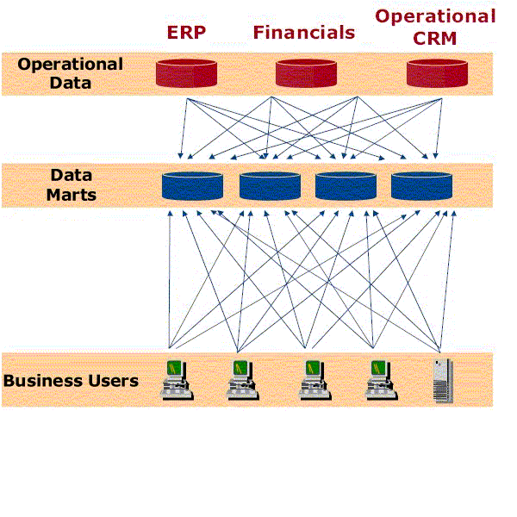
Distributed Approach to DSS
Various departments can start creating different data marts. Each can start working independently and see the ROI in a short span. In the long run integrating these data adds the complexity and Cost will be higher as there are more systems to maintain.
How We Are Different

Slide 16
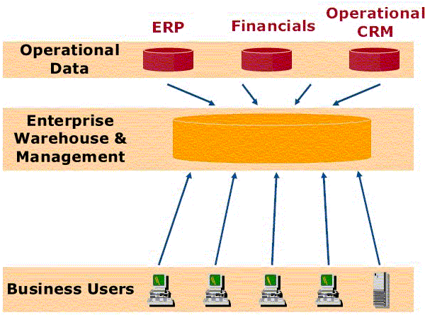
Centralized Approach to DSS
Delivers one version of the truth for increased confidence and speed in decision-making
How We Are Different
Notes:
ENTERPRISE DATA WAREHOUSE:
Wal-Mart does 100 million rows updated per day; 40-50K queries/day; with 10K users.
This is a good place to ask the customer what they think are the advantages of this architecture. One customer answered:
One set of data collection
All data in one place
Simpler management
Consistency – common data
Single source of data
The disadvantage that customer listed was that everyone has to agree. Point out that that has nothing to do with technology.

Slide 17
Hybrid Approach
SMG
Datamart
Step 1
To get best of both worlds, you choose this to implement the data warehouse.
Start with one DM by choosing the department which needs analytics the most.
Once you see the ROI, you can decide on adding one more subject area at a time.
The time duration to add subsequent subject area becomes much lesser and we can reuse most of the code we developed.
SMG + Customer
Analytics
Step 2
SMG + Customer+
Employee + vendor +
Finance + assets etc
Analytics
Step n

Slide 18
Different Approaches
Bill Inmon’s approach: Data warehouse is one part of the overall business intelligence system. An enterprise has one data warehouse, and data marts source their information from the data warehouse. In the data warehouse, information is stored in 3rd normal form.
Ralph Kimball’s approach: Data warehouse is the conglomerate of all data marts within the enterprise. Information is always stored in the dimensional model.

Slide 19
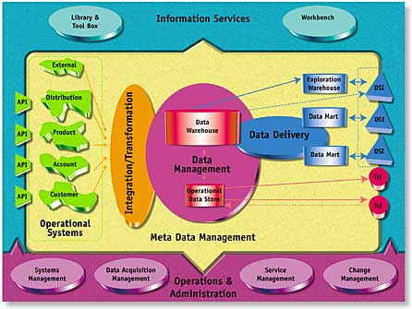

Corporate Information Factory

Slide 20
Data Granularity
What is Granularity of your DW?
Granularity is the level of details we want to store in the data warehouse.
For a retail store, Point of Sale (POS) is the lowest granularity information available.
For banking it’s the account level details based on every day transactions.
As DSS is learning towards analyzing the data as a whole, not necessarily the data warehouse will have all the details up to daily transactions.

Slide 21
Current DW (Weekly Granularity)
BI Layer
Source Data
ETL Layer
Data Layer
Pre
Defined
Reports
Data
Warehouse
Database
ETL
(Tool or
TSQL)
OLTP 1
Ad hoc
Reporting
OLTP 2
Database
(weekly level aggregation)
OLAP
Cubes
Market Place
Staging DB
Web clicks
Data Mining
Meta Data
Close the loop (write back to OLTP about the findings in DSS

Slide 22
DW with both ODS and DW
Data Layer
BI Layer
Source Data
ETL Layer
Data
Warehouse
Database
Pre
Defined
Reports
ETL
(Tool or
TSQL)
OLTP 1
ODS
(Daily level
Aggregation)
Ad hoc
Reporting
OLTP 2
Database
(weekly level aggregation)
OLAP
Cubes
Market Place
Staging DB
Web clicks
Data Mining
Meta Data
Close the loop (write back to OLTP about the findings in DSS

Slide 23
Components of DSS
Source systems
Existing RDBMS
Files
External Data (Market data)
Extract, Transform and Load (ETL)
Do the transformation before loading to DW, not by using the staging database (tool should be capable of doing transformation in memory)
ETL tools are Informatica, Data Stage, SSIS, Ab Initio etc
Business Intelligence
The we deliver valuable information to our end users
BI tools are BO, Cognos, Microstrategy, OLAP tools etc

Slide 24
ETL (E – Extract)
Extract – Getting data from the source systems. Source system can be an RDBMS, Flat files, XML or any other main frame data.
When you are running an ETL job (which transfers the data from source system to target), the initial step is to get the data. This may be a SQL (if the data is in the database), or opening the file and reading etc.
In SQL Server we can use a DTS/SSIS packages to get the data from the database or flat files.
Some time, you will read the entire table – we call it as full extract. Some, time, you will read only the new or changed data – we call it as partial extract or incremental extract.

Slide 25
ETL (T – Transform)
Transform – Its not necessary to have the same data model in source and destination. When the data model is different from source obviously we have to modify the source data to destination’s data model. This process is called transformation.
Example : When we receive data from various disti’s about the reseller information we wont get the geo information. So in the transformation logic we will have some code which assigns the respective geo based on the country from which you are getting the data.
This is the simple example on transformation.

Slide 26
ETL (L – Load)
Load – Loading the transformed data into the destination data mdoel (data warehouse / data mart).
Based on the target where you are loading the data, you will end up choosing the technology.
If your target is RDBMS, then you may choose SQL or utilities of RDBMS to load the data.
You can have a flat file as the target as well.
While loading some of the records may fail because of the database constraints, usually in data warehousing we capture this data as rejected records.

Slide 27
Data Transformation Terms
Extracting
Conditioning
Scrubbing
Merging
Householding
Aggregation
Rejection
Splitting
Enrichment
Scoring
Loading
Validating
Delta
Matching
De duplication

Slide 28
Data Modeling for DW
DW Model
Normalization
(3rd NF)
De normalization
(Dimensional Modeling)
Completely normalized
Star Schema
Snow Flake
Completely de normalized
Partially de normalized

Slide 29
De-normalization
De normalization is the process through which we make our models ready for reporting / analytics.
De normalization helps to understand the model we deal with from business sense and helps to select the data faster as the number of tables are less.
We can have complete de normalization method or partial de normalization method while creating the De normalization model.
Complete de normalization leads star schema, partial de normalization leads to Snowflake schema.
Dimension table in star schema contains all the hierarchical elements in one table.

Slide 30
Schema Design
Database organization
must look like business
must be recognizable by business user
approachable by business user
Should help analytics (ease of query)
Must be simple
Schema Types
Star Schema
Snowflake schema

Slide 31
Dimension Tables
Dimension tables
Define business in terms already familiar to users
Wide rows with lots of descriptive text
Small tables (about a million rows)
Joined to fact table by a foreign key
heavily indexed
typical dimensions
time periods, geographic region (markets, cities), products, customers, salesperson, etc.

Slide 32
Fact Table
Central table
mostly raw numeric items
narrow rows, a few columns at most
large number of rows (millions to a billion)
Access via dimensions
All the dimension keys will be part of primary key

Slide 33
Tables in the 3rd NF Vs Dimensional
Master Tables
Detail Tables
Type tables
Transaction tables
Emp_type
payroll
dept
employee
Emp_projects
timesheet
Cust_type
customer
projects

Slide 34
Tables in the 3rd NF Vs Dimensional
Master Tables
Detail Tables
Type tables
Transaction tables
Dimension Table
Fact Table
Emp_type
payroll
Employee
Period
dept
employee
Time
fact
Payroll
fact
Emp_projects
timesheet
Cust_type
Projects
customer
projects

Slide 35
Slowly Changing Dimension
TYPE 1
No history stored
TYPE 2
Complete history stored. We have to generate a unique key called surrogate ID’s in this type of tables
TYPE 3
Only current and previous values are stored for a physical key record. (em_name, pre_emp_name)

Slide 36
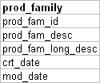
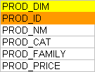

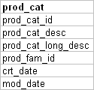
Type1 dimension

Slide 37
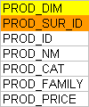
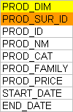
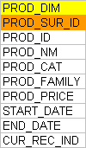
Type 2 (types of implementations)
Only with surrogate id
Storing changes with duration
With current record indicator

Slide 38
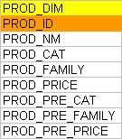
Type 3 (implementation)

Slide 39
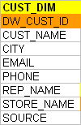
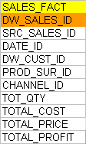
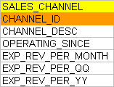
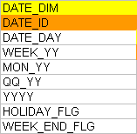
Sales Analysis System (Lowest Grain)

Slide 40
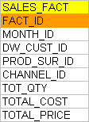

DW for Sales Analysis (monthly)

Slide 41
Fact Less Fact tables
Usually fact table has all the measures through which you measure the performance of the business.
Typical fact table has qty, cost, price, discount, margin columns where you can apply aggregate functions.
In some cases, we wont be having these kind of measures ex: any event tracking DW
Web click analysis, attendance system etc are the examples
In the above mentioned systems, the existence of the record becomes the fact. So in web click analysis the combination of user, date and webpage is the fact.

Slide 42
Measure Types
Fully additive measure
Where we can apply any aggregate functions with any dimensions in that star schema
Semi additive measure
We wont be able to apply all aggregate functions in this type of column (Ex: percentage)
Non additive measure
We wont be able to apply any aggregate functions in this type of column (Ex: Tran_type = ‘S’ or ‘R’)

Slide 43
Snow flake
Snow flake won’t have much of redundant data as most of the dimensions will have a look table. This way the number of joins between the tables will become more.
Even in snow flake we will have the dimensions and facts only. Only difference is we normalize the dimension table based on the hierarchy.
A dimension has minimum of one hierarchy. Some of the dimensions can have multiple hierarchy.
Both have advantages and dis advantages, so analyze the end user’s requirements and space constraints to pick the best.
If you are design is such a way that you have too many aggregation tables then we can go with Snowflake.

Slide 44
The “Snowflake” Schema
Store Dimension
STORE KEY
District_ID
Region_ID
Store Description
City
District ID
State
District Desc.
Region_ID
Region Desc.
Regional Mgr.
Store Fact Table
STORE KEY
PRODUCT KEY
PERIOD KEY
Dollars
Units
Price
Notes:
13
Notice how the Store dimension table generates subsets of records. First, all records from the table (where level = ìDistrictî in the Star) are extracted, and only those attributes that refer to that level (District Description, for example) and the keys of the parent hierarchy (Region_ID) are included in the table. Though the tables are subsets, it is absolutely critical that column names are the same throughout the schema.
The diagram above is a partial schema - it only shows the ìsnowflakingî of one dimension. In fact, the product and time dimensions would be similarly decomposed as follows:
Product - product -> brand -> manufacturer (color and size are extended attribute characteristics of the attribute ìproduct,î not part of the attribute hierarchy)
Time - day -> month -> quarter -> year

Slide 45
Snow flake - Insurance model
Cat_lookup
Cat_id
Cat_desc
org_dim
Org_id
Name
Cat_id
Manager_nm
cust_dim
State_lookup
txn_fact
Cust_id
Name
Address
Phone
State_id
State_id
State_desc
Org_id
Emp_id
Cust_id
Policy_id
Cal_date_id
Payment_amt
Claims_amt
dept_lookup
emp_dim
Dept_id
Dept_name
Emp_id
Ename
Join date
Sal
Dept_id
policy_dim
Policy_id
Name
Start_date
End_date
Year_lookup
Year_id
year
Cal_dim
Quarter_lookup
Week_lookup
Cal_date_id
Date
Week_id
Quarter_id
Quarter
Year_id
month_lookup
Week_id
Cal_week
Month_id
Month_id
Cal_month
Quarter_id

Slide 46
What is OLAP?
What is OLAP?
Online Analytical Processing.
Viewing data in a multi dimensional way.
Why OLAP?
“Slice and dice” for data warehouse.
OLAP is a multi dimensional way of storing / viewing the data
RDBMS is a 2 dimensional way of storing / viewing the data

Slide 47
Types in OLAP?
Three types of OLAP in the industry.
ROLAP – Relational OLAP ( Ex Business Objects, Microstrategy).
MOLAP – Multi dimensional OLAP (Ex MSOLAP, Essbase, Cognos).
HOLAP – Hybrid OLAP

Slide 48
Architecture diagram of ROLAP
App Server
ROLAP tools
Like
BO
Cognos
Microstrategy
Etc
BI Metadata
Data Warehouse
/
Data Mart
/
Or ODS
OLAP
Report1
OLAP
Report2
OLAP
Report n
When a report is executed by end user the actual SQL is issued to RDBMS to get the data. Some BI tools can even store the results set in the application server and periodically refresh that report based on the data refreshes which happen in DW.

Slide 49
OLAP functionality
Drill down (state -> City -> Customer -> Account
Drill Up ( Customer -> City -> State
Drill through (City -> Customer -> Product name)
Drill Across (City -> Customer sales -> web clicks )
Time
Dimension
product
dimension
sales
fact
Web click
fact
Customer
dimension

Slide 50
Architecture of MOLAP
OLAP
Report1
Microsoft
Analysis
Services
BI Metadata
Cube defn
etc
MOLAP
cubes
DataWarehouse
Or
Data Mart
OLAP
Report2
MOLAP
cubes
OLAP
Report n
When a report is executed by end user the actual data is retrieved from the MOLAP cubes. The way it retrieves by using MDX queries based on the report. MDX stands for Multidimensional expression. SQL is used to get the data RDBMS, MDX is used to get the data from MOLAP. The MOLAP cubes are refreshed periodically based on the data refreshes which happen in DW.

Slide 51
Terminology
Cube –
A cube is a multidimensional structure of data. Cubes are defined by a set of dimensions and measures.
Notes:
Points
Click – Measures – numeric details that are used in calculations (Sales revenue, number of units)
Click – Members - attributes of a measure that help describe a measure (Jan, Feb, Mar, red, blue, green)
Click - Levels - a group of like members (Month, Colors)
Click – Dimensions – a structure that organizes levels into a hierarchy (Time)
Click – Cube - is a logical collection of Measures and Dimensions (levels and members)
Narrative
In order to get off to a solid start, let’s take a couple of minutes to define some of the basic terminology.
Click
Measures are the numeric data of interest such as number of items and revenue per sale. Measures are typically used in arithmetic functions so that we can explore how they behave when grouped differently or to derive other measures. Measures are taken from the fact table of a star or snowflake schema.
Click
Members represent data within a dimension’s level. For example, January is a member of the Month level in the Time dimension
Dimensions provides a hierarchical organization to its members. For example Time can be measured in a hierarchy of Months, Weeks, Days, and so on. These are called levels and are ordered from least granular (Year) to most granular (Day).
Click
Cubes are the containers for measures, dimensions, aggregations, and partitions. Cubes are based on a single fact table.
A cube can contain up to 63 dimensions (actually 64, here’s a hint for more advanced users, measures are frequently referenced as members of a dimension).

Slide 52
Terminology
Location
Dimension –
A structural attribute of a cube that acts as an index for identifying values within a multi-dimensional array.
If all dimensions have a single member selected, then a single cell is defined.
Products
Time
Notes:
Points
Click – Measures – numeric details that are used in calculations (Sales revenue, number of units)
Click – Members - attributes of a measure that help describe a measure (Jan, Feb, Mar, red, blue, green)
Click - Levels - a group of like members (Month, Colors)
Click – Dimensions – a structure that organizes levels into a hierarchy (Time)
Click – Cube - is a logical collection of Measures and Dimensions (levels and members)
Narrative
In order to get off to a solid start, let’s take a couple of minutes to define some of the basic terminology.
Click
Measures are the numeric data of interest such as number of items and revenue per sale. Measures are typically used in arithmetic functions so that we can explore how they behave when grouped differently or to derive other measures. Measures are taken from the fact table of a star or snowflake schema.
Click
Members represent data within a dimension’s level. For example, January is a member of the Month level in the Time dimension
Dimensions provides a hierarchical organization to its members. For example Time can be measured in a hierarchy of Months, Weeks, Days, and so on. These are called levels and are ordered from least granular (Year) to most granular (Day).
Click
Cubes are the containers for measures, dimensions, aggregations, and partitions. Cubes are based on a single fact table.
A cube can contain up to 63 dimensions (actually 64, here’s a hint for more advanced users, measures are frequently referenced as members of a dimension).

Slide 53
Terminology
Location
China
Peru
Japan
Italy
Measures –
Numeric data of interest.
e.g. Revenue per Sale, Quantity
Coffee
Apples
Tea
Onions
Products
€1.95
January
February
March
April
Time
Notes:
Points
Click – Measures – numeric details that are used in calculations (Sales revenue, number of units)
Click – Members - attributes of a measure that help describe a measure (Jan, Feb, Mar, red, blue, green)
Click - Levels - a group of like members (Month, Colors)
Click – Dimensions – a structure that organizes levels into a hierarchy (Time)
Click – Cube - is a logical collection of Measures and Dimensions (levels and members)
Narrative
In order to get off to a solid start, let’s take a couple of minutes to define some of the basic terminology.
Click
Measures are the numeric data of interest such as number of items and revenue per sale. Measures are typically used in arithmetic functions so that we can explore how they behave when grouped differently or to derive other measures. Measures are taken from the fact table of a star or snowflake schema.
Click
Members represent data within a dimension’s level. For example, January is a member of the Month level in the Time dimension
Dimensions provides a hierarchical organization to its members. For example Time can be measured in a hierarchy of Months, Weeks, Days, and so on. These are called levels and are ordered from least granular (Year) to most granular (Day).
Click
Cubes are the containers for measures, dimensions, aggregations, and partitions. Cubes are based on a single fact table.
A cube can contain up to 63 dimensions (actually 64, here’s a hint for more advanced users, measures are frequently referenced as members of a dimension).

Slide 54
Meta data
Relational Databases
Extraction Cleansing
Optimized Loader
ERP
Systems
Data Warehouse Engine
Analyze Query
Purchased Data
Legacy Data
Metadata Repository

Slide 55
Approach of implementing DW
Data Modeling is a cyclic process involving the following steps
Requirement Gathering
Requirement Analysis
Requirement Validation
Logical Modeling
Physical Design
Implementation
Validation
The above cycle repeats for any upgrades or enhancements

Slide 56
For a Successful Warehouse
From day one establish that warehousing is a joint user/builder project
Establish that maintaining data quality will be an ONGOING joint user/builder responsibility
Train the users one step at a time
Consider doing a high level corporate data model in no more than three weeks
Look closely at the data extracting, cleaning, and loading tools
Implement a user accessible automated directory to information stored in the warehouse
Determine a plan to test the integrity of the data in the warehouse
From the start get warehouse users in the habit of 'testing' complex and exceptional scenarios.

